Slide 1
URL module

Slide 2
URL module
The url module provides utilities for URL resolution and parsing. It can be accessed using:
var url = require('url');

Slide 3
URL module
A URL string is a structured string composed of several meaningful components.
Url module is one of the core modules that comes with node.js, which is used to parse the URL and its other properties.
The Node.js URL Module is provided to perform operations with address URLs.
We can split a web address into manageable parts.
A URL string may carry information including the protocol such as https, the hostname, query string values, and more.

Slide 4
url.parse() method
The url. parse() method takes a URL string, parses it, and it will return a URL object with each part of the address as properties.
Parameters: This method accepts three parameters
url.parse( urlString, parseQueryString)

Slide 5
url.parse() method parameters
urlString: It holds the URL string which need to parse.
parseQueryString: It is a boolean value. If it set to true then the query property will be set to an object returned by the querystring module’s parse() method. If it set to false then the query property on the returned URL object will be an unparsed, undecoded string. Its default value is false.

Slide 6
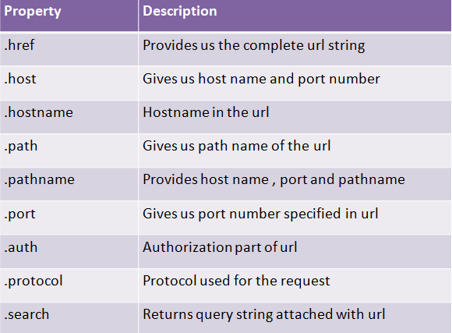
URL module

Slide 7
Reading Query Parameters in Node.js
The query parameter is the variable whose value is passed in the URL in the form of key-value pair at the end of the URL after a question mark (?).
Example:
http://localhost:8000?name=abc where, ‘name’ is the key of query parameter whose value is ‘abc’.

